Slide 1
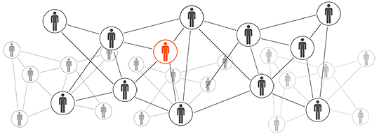

RNS Raw Notification Service
Sy Le Kha
.Net Developer
Lekhasy@outlook.com
Binh Duong University

Slide 2
Contents
What is RNS?
Demo.
What about social network?

Slide 3
What is RNS?
Raw Notification Service

Slide 4
What is RNS?
RNS is a solution which provide an efficient way for storing and sending notifications to windows 10 devices.
Notes:
Microsoft notification hub

Slide 5


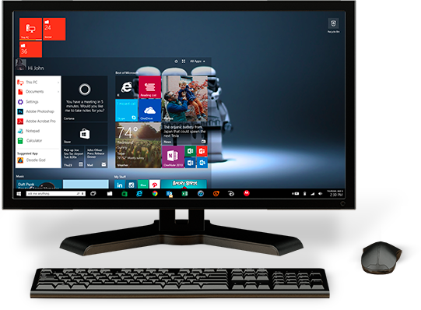
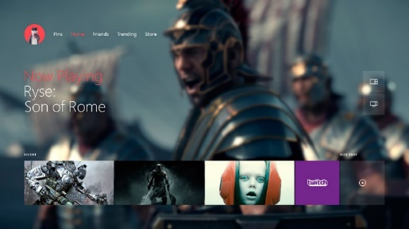
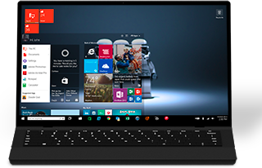
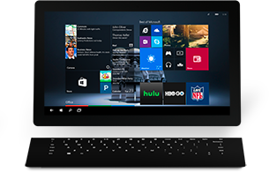
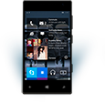

ONE WINDOWS
Phone
Tablet
Classic Laptop
Desktops & All-in-Ones
Xbox

Slide 6
RNS is more than just a service
AES
Windows 10 App
RNS Server
RNS Client
Micorsoft WNS

Slide 7
Demo
Raw Notification Service

Slide 8
But, what about social network?
Raw Notification Service

Slide 9



RNS

Slide 10
Can my system use RNS to send notifications to my users?

